Slide 1

Rogue Realm
Coeur d’Game
Caleb Carter, Jacob Porath, Joe Schlegel, Michael Knutson, Lacey Hunt

Slide 2
Goal
Rogue Realm:
Rogue-like dungeon crawler with a focus on random generation and unique sessions through the game. No two runs will be exactly alike!
The game has no defined ending. The player can continue as long as they are able to stay alive, but each completed level will increase the difficulty.

Slide 3
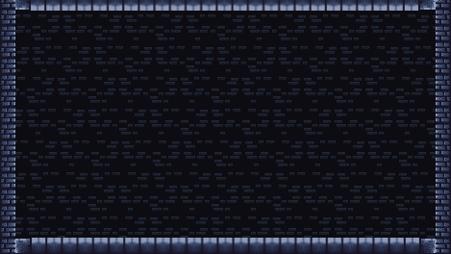

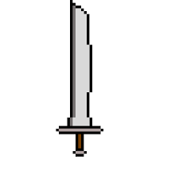



Game opens to main menu screen.

Slide 4

The player chooses “start”.

Slide 5
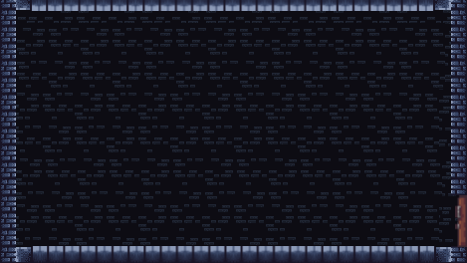

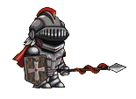
A level is generated, and the player is shown their character in a random starting room.

Slide 6
The player can interact with doors to move from room to room.

Slide 7
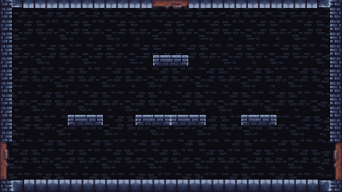
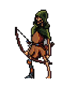
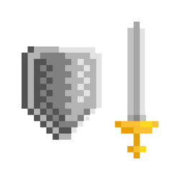
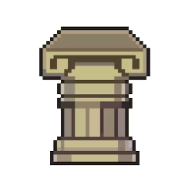
Contents of each room are also random. This room has an enemy, some platforms, a weapon, and a few crates.

Slide 9
The player jumps onto the platforms and defeats the enemy.

Slide 11

Crates can be destroyed. Each crate has a chance to drop coins or health items. This one dropped a coin.

Slide 12
Collecting coins will increase the player’s score at the end.

Slide 13
Weapons can be found on pedestals like this one. Different weapons will allow the player character to attack in different ways.

Slide 14
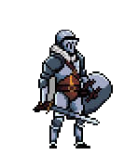
The player now has a sword and shield.

Slide 16
Doors are not limited to only left and right. The player may also move through paths above and below.

Slide 17
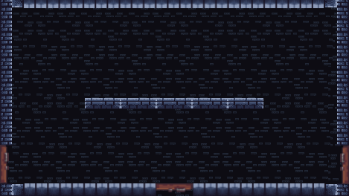
Another example of a possible room. This one contains a different pattern of platforms, another basic enemy, and a chest.

Slide 18
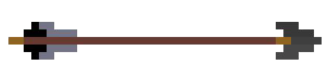
The enemy fires an arrow at the player.

Slide 19

The player gets hit and their health goes down.

Slide 20
As long as the player’s health is not 0, they can continue to play like normal, attacking and defeating enemies.

Slide 22

Chests can be opened to get items which change the player’s stats, making them more powerful.

Slide 23

This one gave the player a potion that increased how much damage they do when attacking.

Slide 24
The player moves to the door on the left and walks through it.

Slide 25

Each generated level will have a boss room. Bosses are tougher enemies that must be beaten before progressing to the next level.

Slide 26
The game will continue until the player dies. The goal is to get through as many levels as possible and increase their score.

Slide 27



The player dropped to 0 health and died. The player character falls to the ground and their score is shown.

Slide 28
The screen fades to black

Slide 29
The screen fades to black

Slide 30
The game ends and the player is shown the main menu where they can begin again or quit the game.

Slide 31
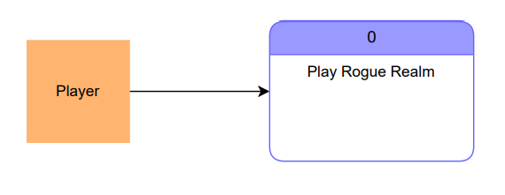
Context Diagram

Slide 32
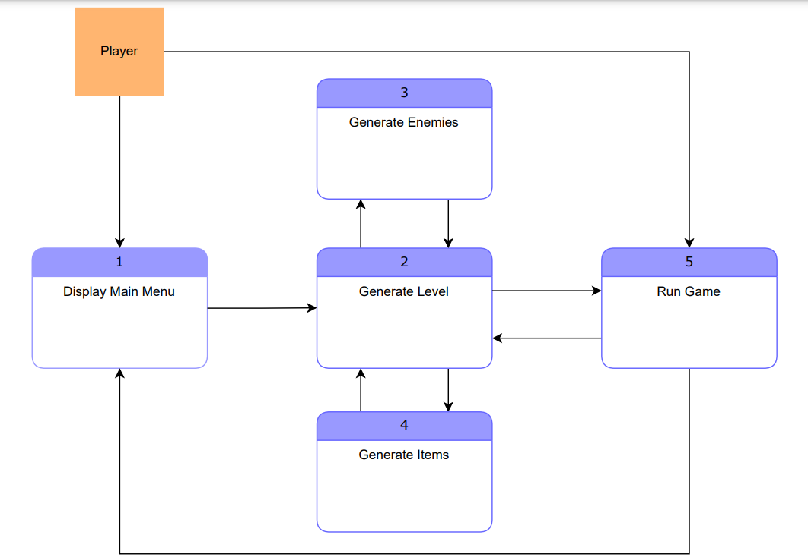
Diagram 0

Slide 33
Lacey - TL2
Main features:
Menus and buttons
Player movement and animation
Handling power ups and calculating score
Priority: Essential
Complexity: Low (menus)/Medium (player)

Slide 34
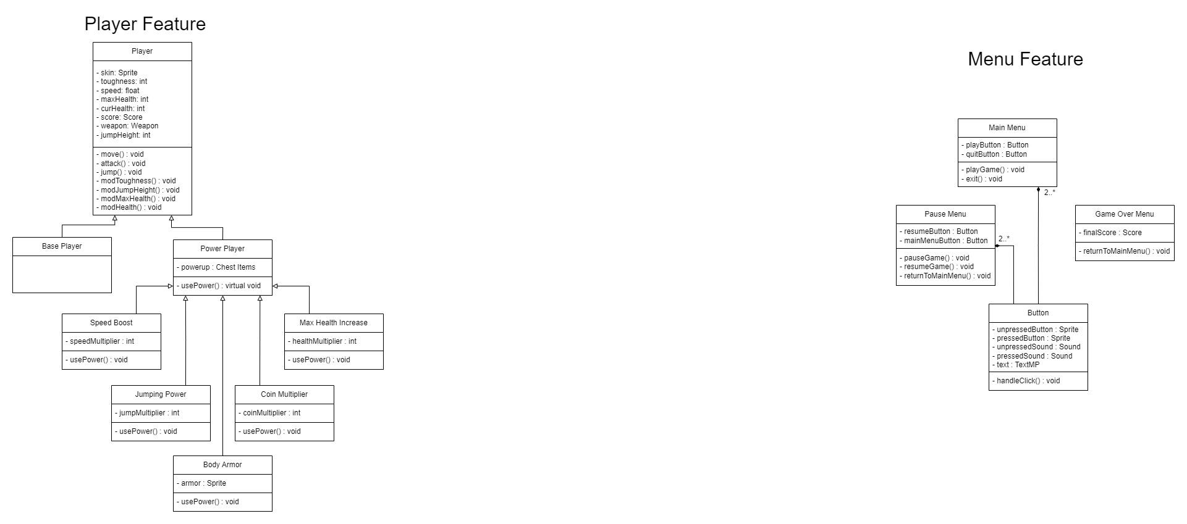
Lacey

Slide 35
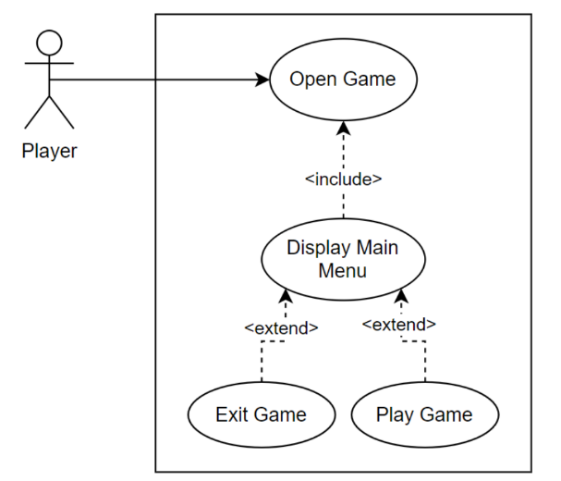
Lacey

Slide 36
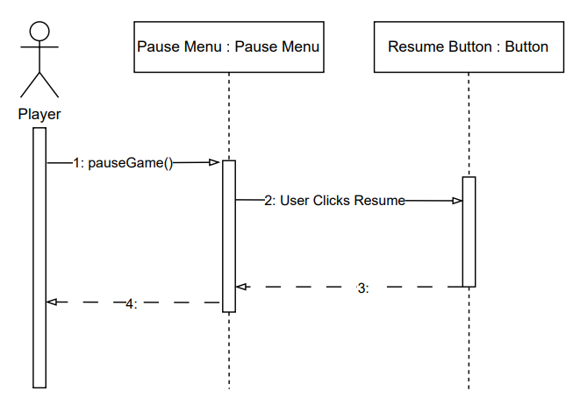
Lacey

Slide 37
Jacob - Level Generation
Main features:
Randomly generated
Unique to each playthrough
Contains branching paths of rooms with items and enemies
A final boss room at the end
Priority: Essential
Complexity: Medium

Slide 38
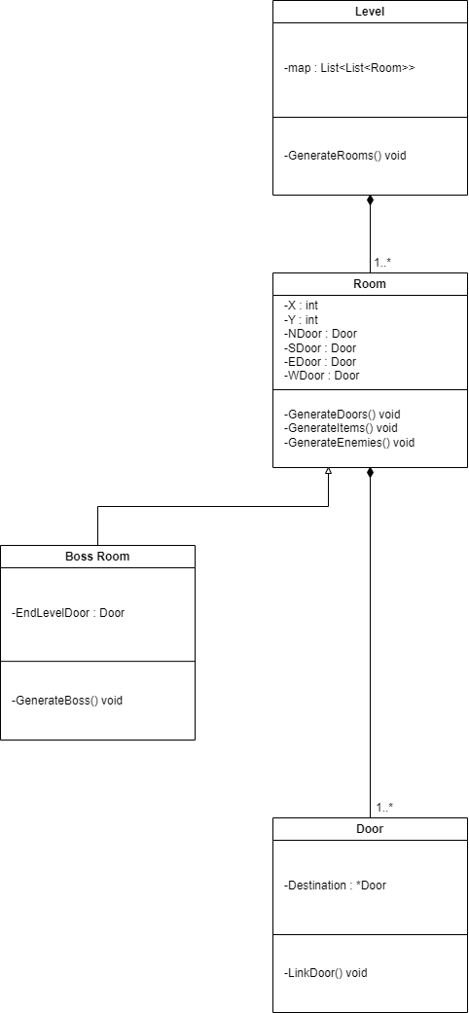
Jacob - Level Generation
Levels:
Normal Rooms
Boss Rooms
Rooms:
Up to four doors
Filled with items and enemies generated for each level.

Slide 39
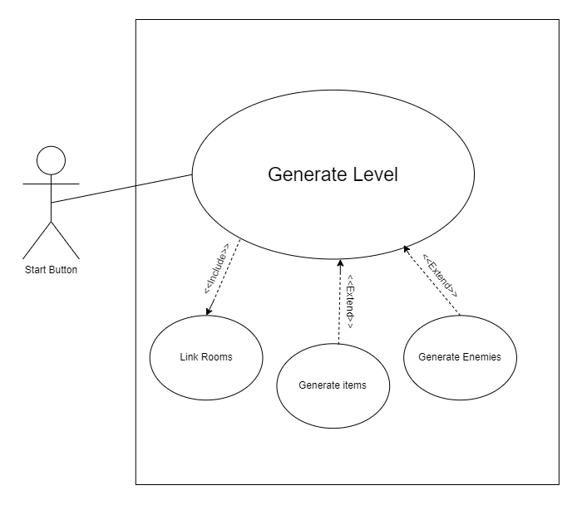
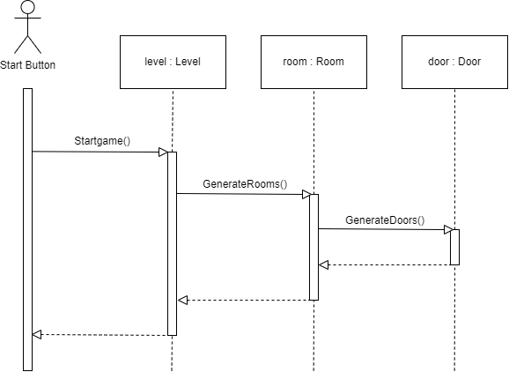
Jacob - Level Generation

Slide 40
Michael (Team Lead 3)
Item Generation
Priority Level:
Medium (team lead role) / Essential (game feature)
Complexity:
Medium (tema lead role) / Medium (game feature)
3 types of items in our game:
Pedestal Items
Weapons (range, melee, and magic weapon types)
Chest Items
Player Power-ups (speed boosts, damage increases, etc..)
Crate Items
Health Boosts and Coins

Slide 41
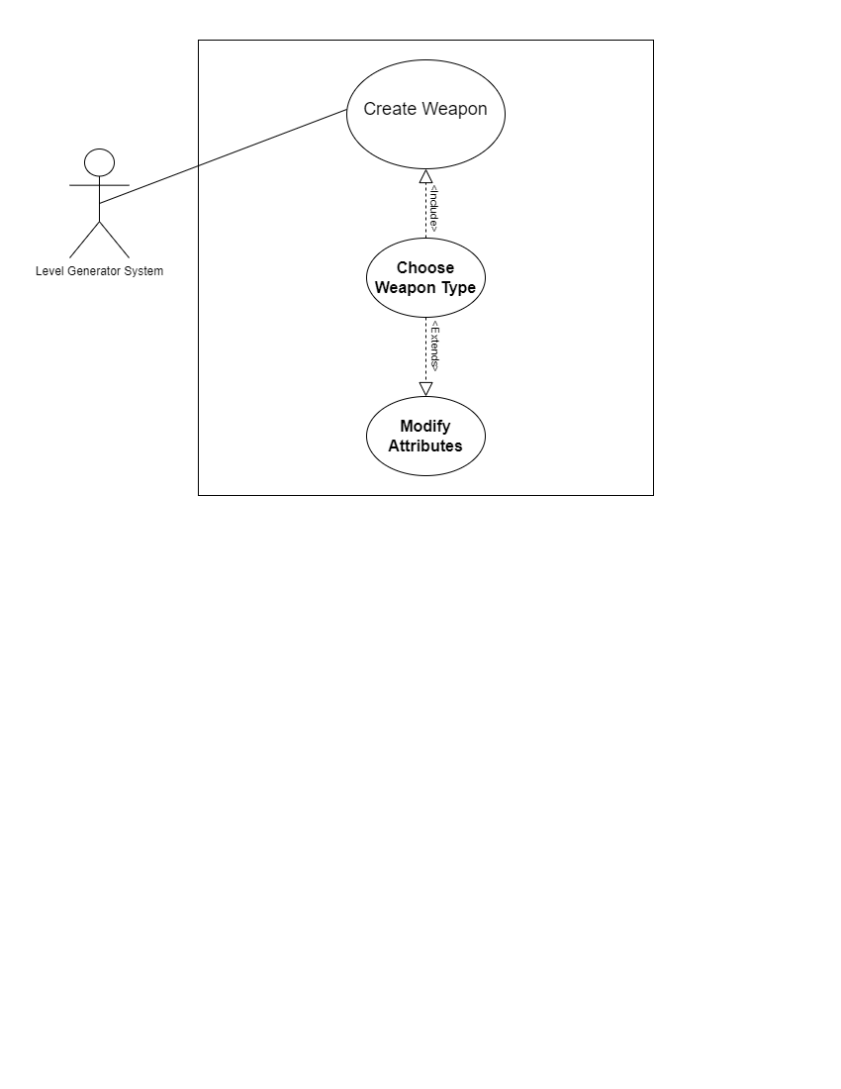
Michael

Slide 42
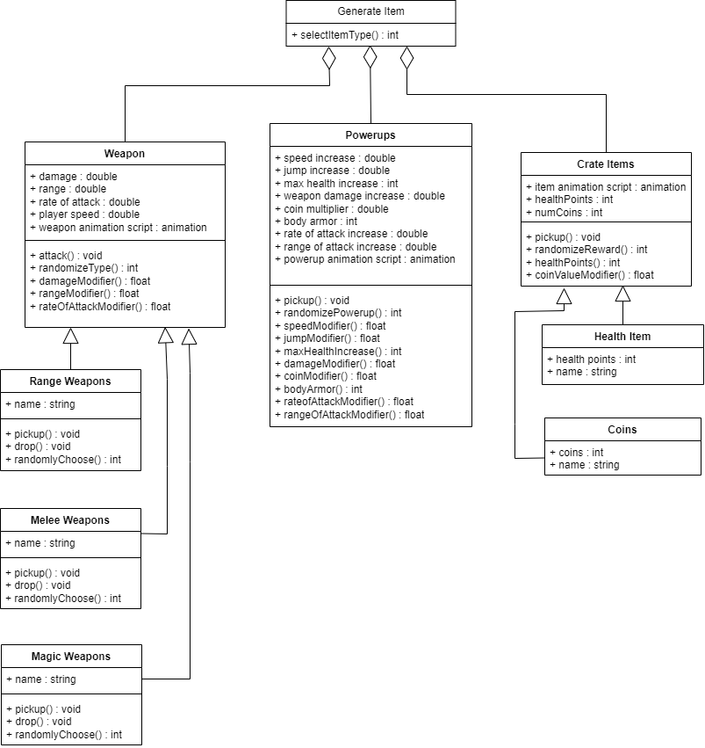
Michael

Slide 43
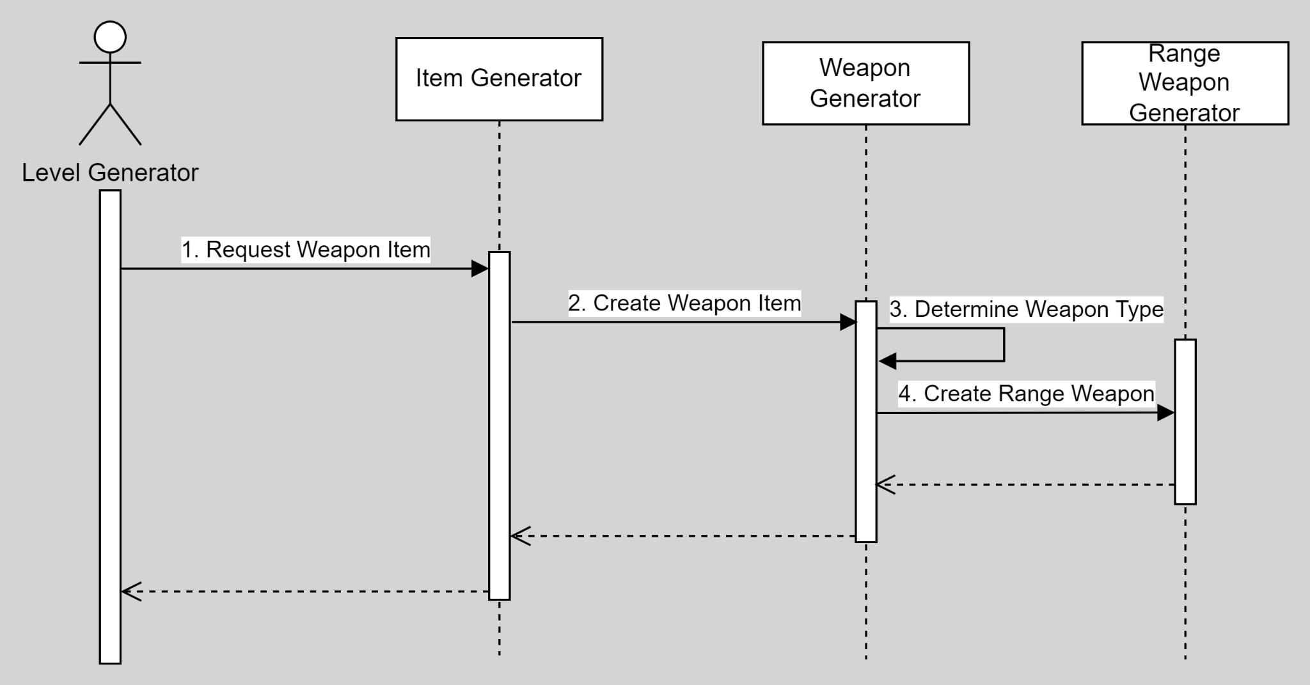
Michael

Slide 44
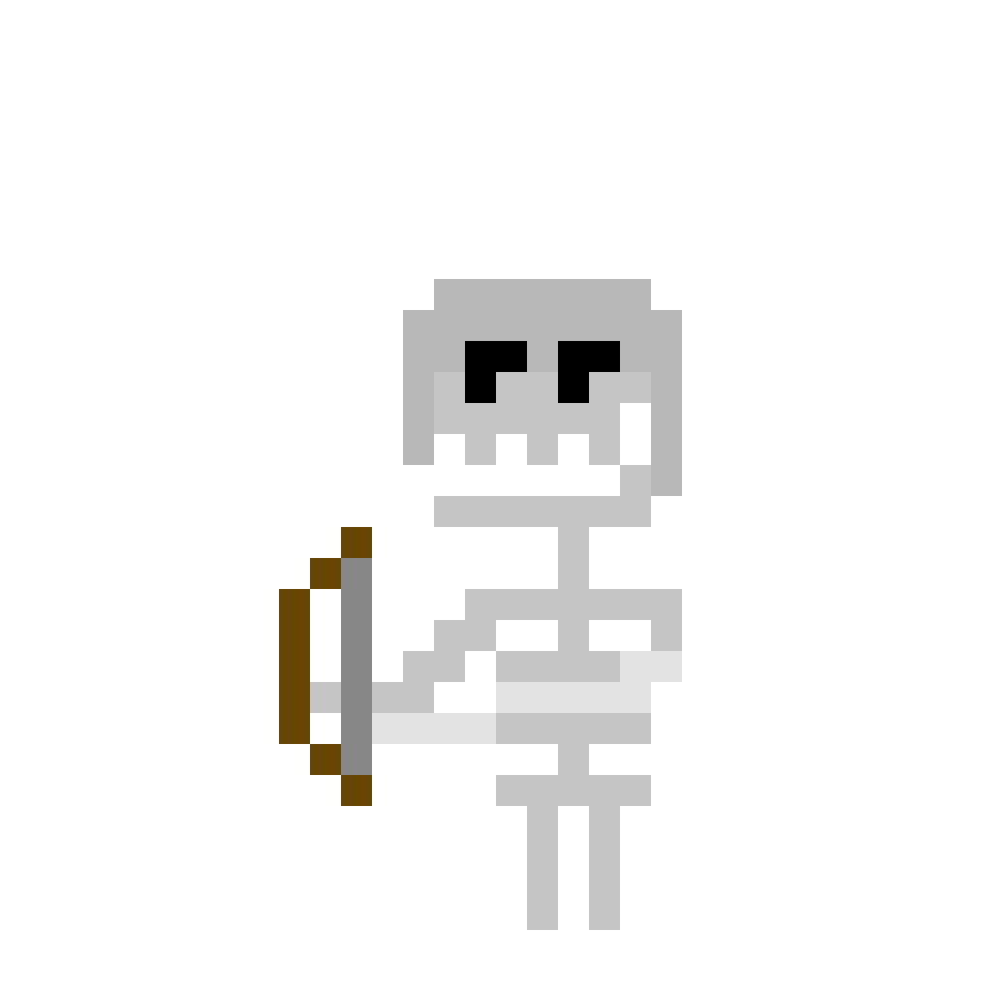
Caleb C, The Bad-Guy Guy!
Caleb C.
Enemy Design! (Priority: Medium, Complexity: Medium)
Enemies will all be derived from a premade library full of multiple types of enemies for different engagements and fights. It will also contain bosses for a challenging fight at the end of each level. An example of an element of the library would contain the following info
-EnemyLibrary[]
-Enemies(non-boss)[]
-Skeleton
-SkeletonBaseStats | -SkeletonSprite | -SkeletonBehaviourScripts

Slide 45
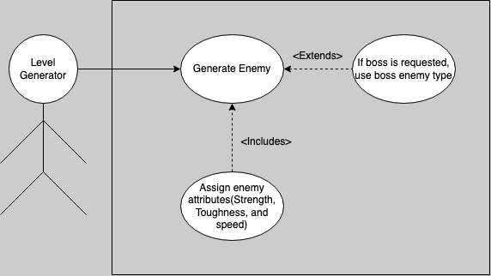
Well, How’s It Work???
Caleb C.
When the Level Generator(Jacob) makes a request for a new enemy to be placed, the Enemy Generator will pull a random enemy from the library, where it will then modify the objects stats based on the current difficulty level, I.E. health, damage, etc, and return a uniquely modified enemy back to the level generator for placement within the game.
This can also be done with bosses when specified.

Slide 46
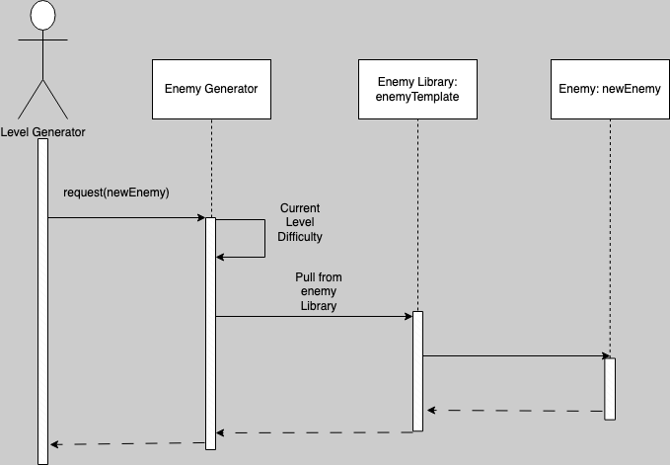
Now In Sequence!
Caleb C.
Another way of looking at it from our sequence diagram. The flow of data is fairly straightforward, making this process fast and efficient. The level generator makes a request, the enemy generator finds a new enemy, it modifies the new enemy’s stats, and the sends it right back to the level generator.
Simple, but effective!

Slide 47
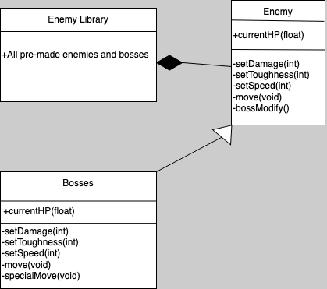
Now Under a Microscope!
Caleb C.
A quick look at the class diagram shows us just how the enemies will be derived from the enemy library and then modified to fit the current gamestage.
With Bosses serving as a subclass of the Enemy class, they can be easily modified and prepped for spawn in the same manner

Slide 48
Joe - Sound Design
Priority: Medium - High
Complexity: Medium
Feature Description:
Sound manager allows different types of sounds to be called uniformly and easily. Sound contributes to every part of the game and must be able to be started/stopped at any point in the game. Aggregation is used to implement a pause feature.
TL6: Porting the game.

Slide 49
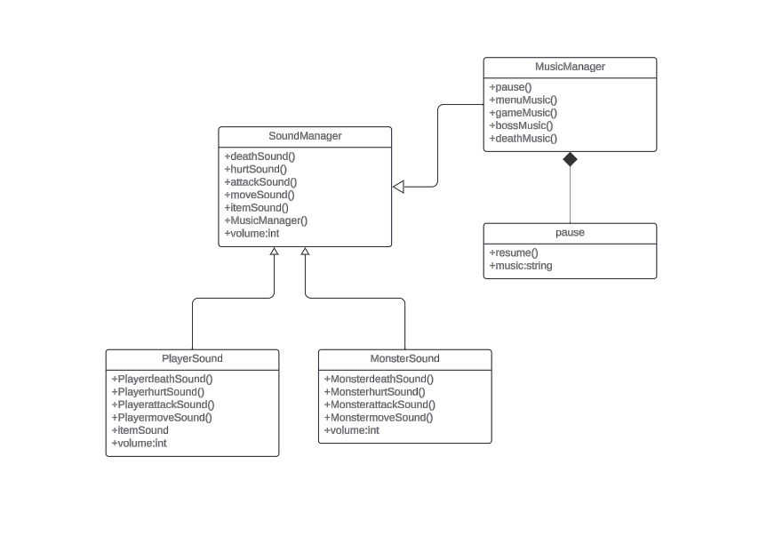
Joe - Sound Design

Slide 50
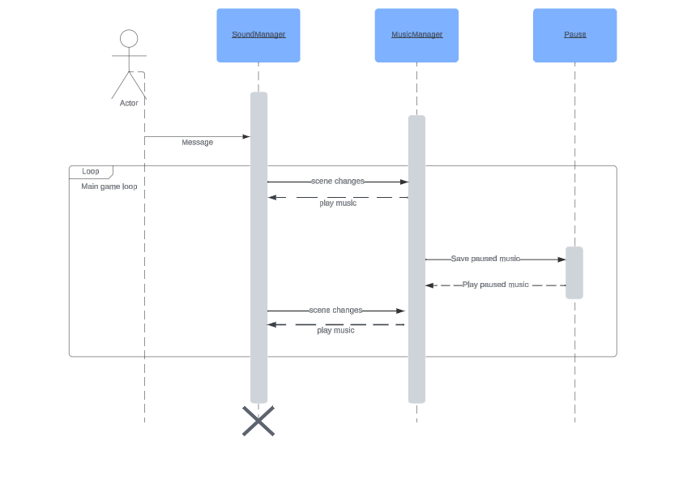
Joe - Sound Design

